Slide 1
Multimodal Depression Detection: Using Audio and Video Analysis with FastAPI
Depression affects millions globally, making early detection essential. Leveraging advancements in AI, this system uses multimodal analysis (audio and video) to detect signs of depression, offering a comprehensive approach to mental health assessment.

Slide 2
TEAM MEMBERS :
DOLE MADHU SRI(100521729020)
MAREDDY SHIVALIKA(100521729036)

Slide 3
Background :
Depression impacts millions globally, yet traditional assessments often miss subtle indicators. Recent advances in AI have enabled multimodal analysis that combines both audio and visual data to better detect depression cues.
This project leverages Whisper for speech-to-text, GloVe embeddings with LSTM for text sentiment analysis, and Custom CNN for visual analysis of facial expressions. By integrating these with FastAPI, this system enables comprehensive and accessible mental health assessment, supporting early detection for improved outcomes.

Slide 4
Unveiling the Power of Models :
In this project, we harness the strengths of multiple advanced models:
Whisper for audio transcription, turning spoken words into text data.
GloVe Embeddings and LSTM for analyzing the emotional tone in speech.
Custom cnn for extracting visual cues related to facial expressions.
These models each bring unique capabilities to the table, and when combined, they provide a powerful tool for multimodal depression detection. This approach illustrates the potential of AI models to deepen our understanding of complex human behaviors, helping pave the way for impactful applications in fields like mental health.

Slide 5
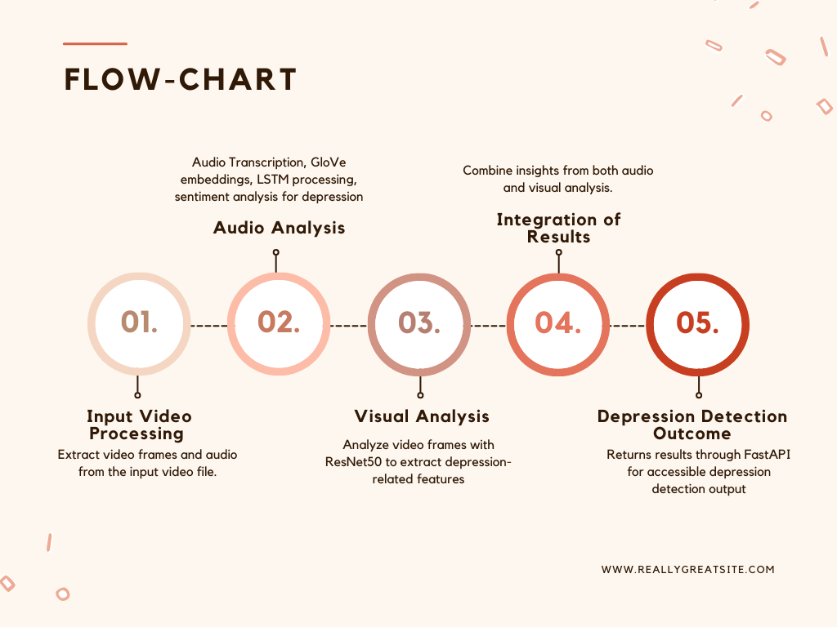

Slide 6
INPUT AUDIO PROCESSING:
Audio Extraction:
Utilizing MoviePy, the system extracts audio from video files, providing the foundation for subsequent processing.
Audio-to-Text Conversion:
The extracted audio is transcribed to text using Whisper, enabling analysis of spoken content for sentiment evaluation.

Slide 7
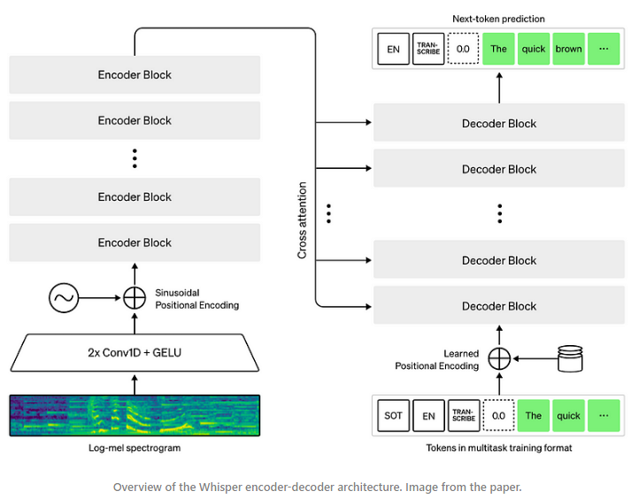

Slide 8
Depression Prediction From Audio Transcription:
Sentiment Analysis:
The transcribed text undergoes sentiment analysis using a Hugging Face transformer model, classifying the sentiment as positive, negative, or neutral.
Depression Prediction:
If the sentiment is determined to be negative, the system predicts depression by leveraging a Kaggle Suicidal dataset and applying:
GloVe Embeddings: For text representation.
LSTM Model: To analyze the sequence and context of the input text for accurate prediction.

Slide 9
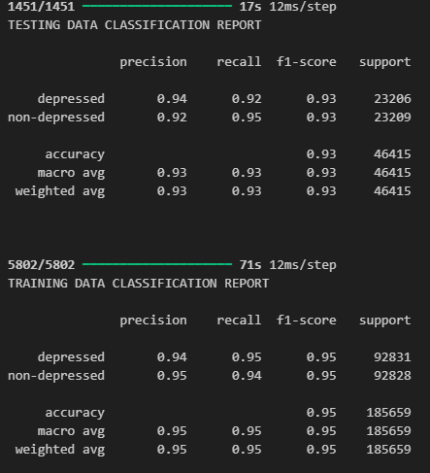

Slide 10
FER (Facial Expression Recognition) Dataset:
Key features of the FER dataset include:
Image Samples: Consists of 35,887 labeled images of human faces.
Expression Categories: Includes expressions like happy, sad, angry, surprised, disgusted, and neutral.
Diversity: Images cover various demographics, ensuring a broad representation of facial expressions.

Slide 11
Preprocessing the Data:
Steps taken to prepare the FER dataset for analysis:
Resizing: Images are resized to fit the input dimensions of the custom CNN.
Normalization: Pixel values are normalized to improve model convergence during training.
Data Augmentation: Techniques like rotation, flipping, and zooming are applied to enhance the dataset and reduce overfitting.

Slide 12
Training the CNN with FER Data
The FER dataset is utilized to train the custom CNN for:
Feature Extraction: Capturing emotional cues from facial expressions.
Classifying Emotions: Using CNN layers to classify emotions effectively.
Model Evaluation: Performance is assessed using metrics like accuracy

Slide 13
Workflow of Visual Analysis:
Key indicators: High sadness, fear, or disgust percentages may indicate depression.
Load video and extract frames.
Detect faces and preprocess for emotion recognition. Predict emotions for each face using CNN.
Calculate emotion percentages and analyze mental health indicators.
Analyzes emotion frequencies across video frames and returns detection based on visuals of video.

Slide 14
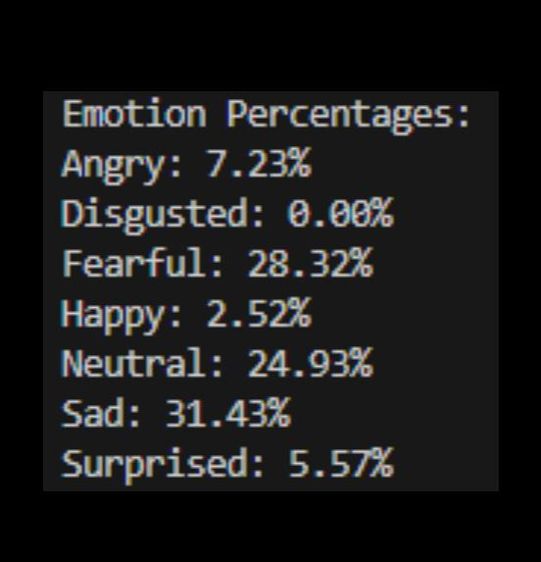
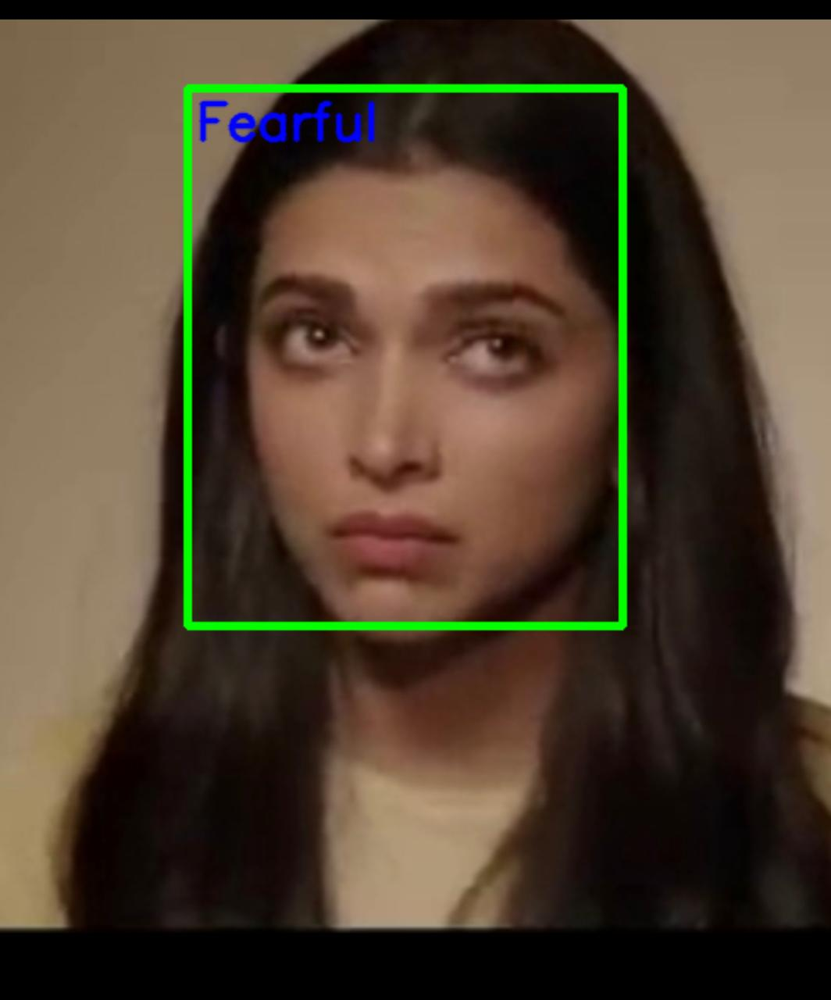

Slide 15
FastAPI Workflow for Depression Detection:
Video Upload: web page which is API endpoint to upload video files.
Processing: Extract frames, detect faces, predict depression from audio and video transcription.
Analysis: Calculate emotion percentages, determine depression or other indicators.
Response: Returns JSON result with mental health insights to web page hosted.

Slide 16
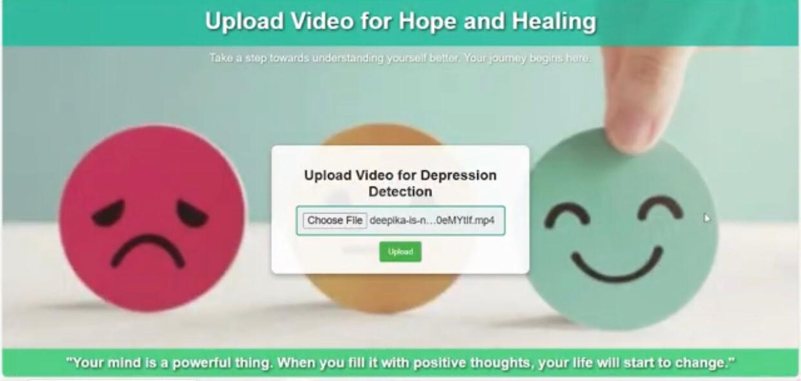
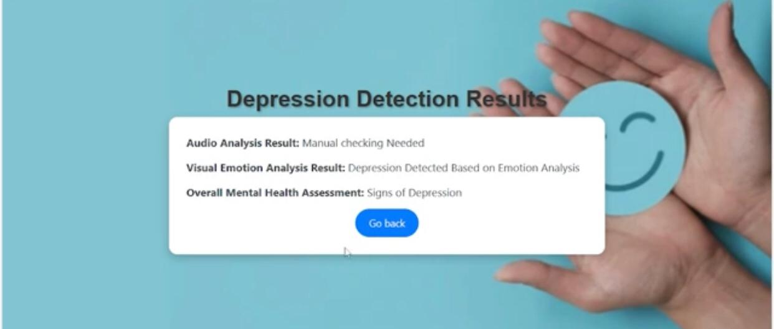
Integration of Audio and Video Results: RESULTS FROM AUDIO ANALYSIS AND VISUAL ANALYSIS ARE TAKEN INTO CONSIDERATION FOR FINAL DEPRESSION DETECTION FROM VIDEO.

Slide 17
Challenges and Future Work
Challenges encountered include:
Imbalanced Classes: Some expressions are underrepresented, impacting model performance.
Generalization: Ensuring the model generalizes well to unseen data.
Future work includes:
Expanding the Dataset: Incorporating additional facial expression datasets for robustness.
Real-time Emotion Detection: Developing applications for real-time analysis and feedback.

Slide 18
THANK YOU

